Slide 1
SynCron: Efficient Synchronization Support for Near-Data-Processing Architectures
周涛 S211000854

Slide 2

CONTENTS
01.
Brief information
02.
Background
03.
Challenges
04.
Solution
05.
Experimental results and conclusion

Slide 3

Brief information
SynCron: Efficient Synchronization Support for Near-Data-Processing Architectures
Authors：Giannoula, Christina；Vijaykumar, Nandita；Papadopoulou, Nikela
National Technical University of Athens and Swiss Fed Inst Technol, Zurich, Switzerland
This article was published on 27th IEEE International Symposium on High-Performance Computer Architecture (HPCA 2021).
The synchronization problem in NDP systems, An end-to-end synchronization solution

Slide 4
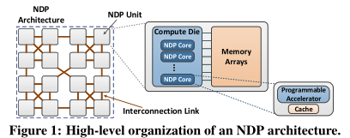
Background
Near-Data-Processing (NDP) architectures present a promising way to alleviate data movement costs. NDP involves performing computation close to where the application data resides.
Typical NDP architectures support several NDP units connected to each other, with each unit comprising multiple NDP cores close to memory.

Slide 5
Background
NDP architectures provide high levels of parallelism, low memory access latency, and large aggregate memory bandwidth.
Many applications (genome analysis, graph processing , neural networks ) exhibit high parallelism, low operational intensity, and relatively low cache locality which make them suitable for NDP.
To fully leverage the benefits of NDP and achieve high performance for parallel workloads, efficient synchronization among the NDP cores of a system is necessary.

Slide 6
Background
Approaches to support synchronization are typically of two types .
1.synchronization primitives can be built through shared memory, most commonly using the atomic read-modify-write (rmw) operations provided by hardware. In CPU systems, atomic rmw operations are typically implemented upon the underlying hardware cache coherence protocols.
2. synchronization can be implemented via a message-passing scheme, where cores exchange messages to reach an agreement.

Slide 7
challenge
Both schemes are built on the shared cache level in CPU systems, which most NDP systems do not have. Moreover, in NDP systems with non-uniform memory access times, most of these prior schemes would incur significant performance overheads under high-contention scenarios. This is because they are oblivious to the non-uniformity of NDP.
1.Most NDP architectures lack shared caches that can enable low-cost communication and synchronization among NDP cores of the system.
2.Hardware cache coherence protocols are typically not supported in NDP systems due to high area and traffic overheads associated with such protocols

Slide 8
challenge
3.NDP systems are non-uniform, distributed architectures, in which inter-unit communication is more expensive (both in performance and energy) than intraunit communication
Some recent NDP works propose message-passing barrier primitives among NDP cores of the system. However, these synchronization schemes are still inefficient, and also lack support for lock, semaphore and condition variable synchronization primitives.

Slide 9
Solution
1. we offload synchronization among NDP cores to dedicated low-cost hardware units,
called Synchronization Engines (SEs).
2. we directly buffer the synchronization variables in a specialized cache memory structure. the Synchronization Table (ST), inside an SE to keep synchronization information.
3. Hierarchical message-passing communication: Each NDP unit including an SE. NDP cores communicate with their local SE that is located in the same NDP unit. SEs communicate with each other to coordinate synchronization at a global level.
4. Integrated hardware-only overflow management.

Slide 10
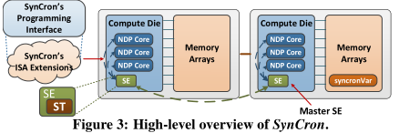
Solution
SynCron adds low-cost hardware support near memory for synchronization acceleration, and avoids the need for hardware cache coherence support.

Slide 11
Experimental results and conclusion
We evaluate SynCron using a wide range of parallel workloads including pointer chasing, graph applications, and time series analysis. Over prior approaches SynCron improves performance by 1.27× on average (up to 1.78×) under high-contention scenarios, and by 1.35× on average (up to 2.29×) under low-contention scenarios.
Our proposed hardware unit incurs very modest area and power overheads when integrated into the compute die of an NDP unit.

Slide 12
Experimental results and conclusion
SynCron is the first end-to-end synchronization solution for NDP systems. SynCron incurs very modest hardware cost, generally supports many synchronization primitives and is easy-to-use.
Our evaluations show that it outperforms prior designs under various conditions, providing high performance both under high-contention (due to reduction of expensive traffic across NDP units) and low-contention scenarios (due to direct buffering of synchronization variables and high execution parallelism).

Slide 13
THANKS FOR ALL

